Slide 1
WEEK 3 PROGRESS REPORT
GenAI Carbon Footprint
Research Internship — Weekly Update
Moteba Rehman — Research Intern
Supervisor: Ms. Zahida Kausar · Faculty Coordinator: Dr. Mehwish Fatima
29 June – 3 July

Slide 2
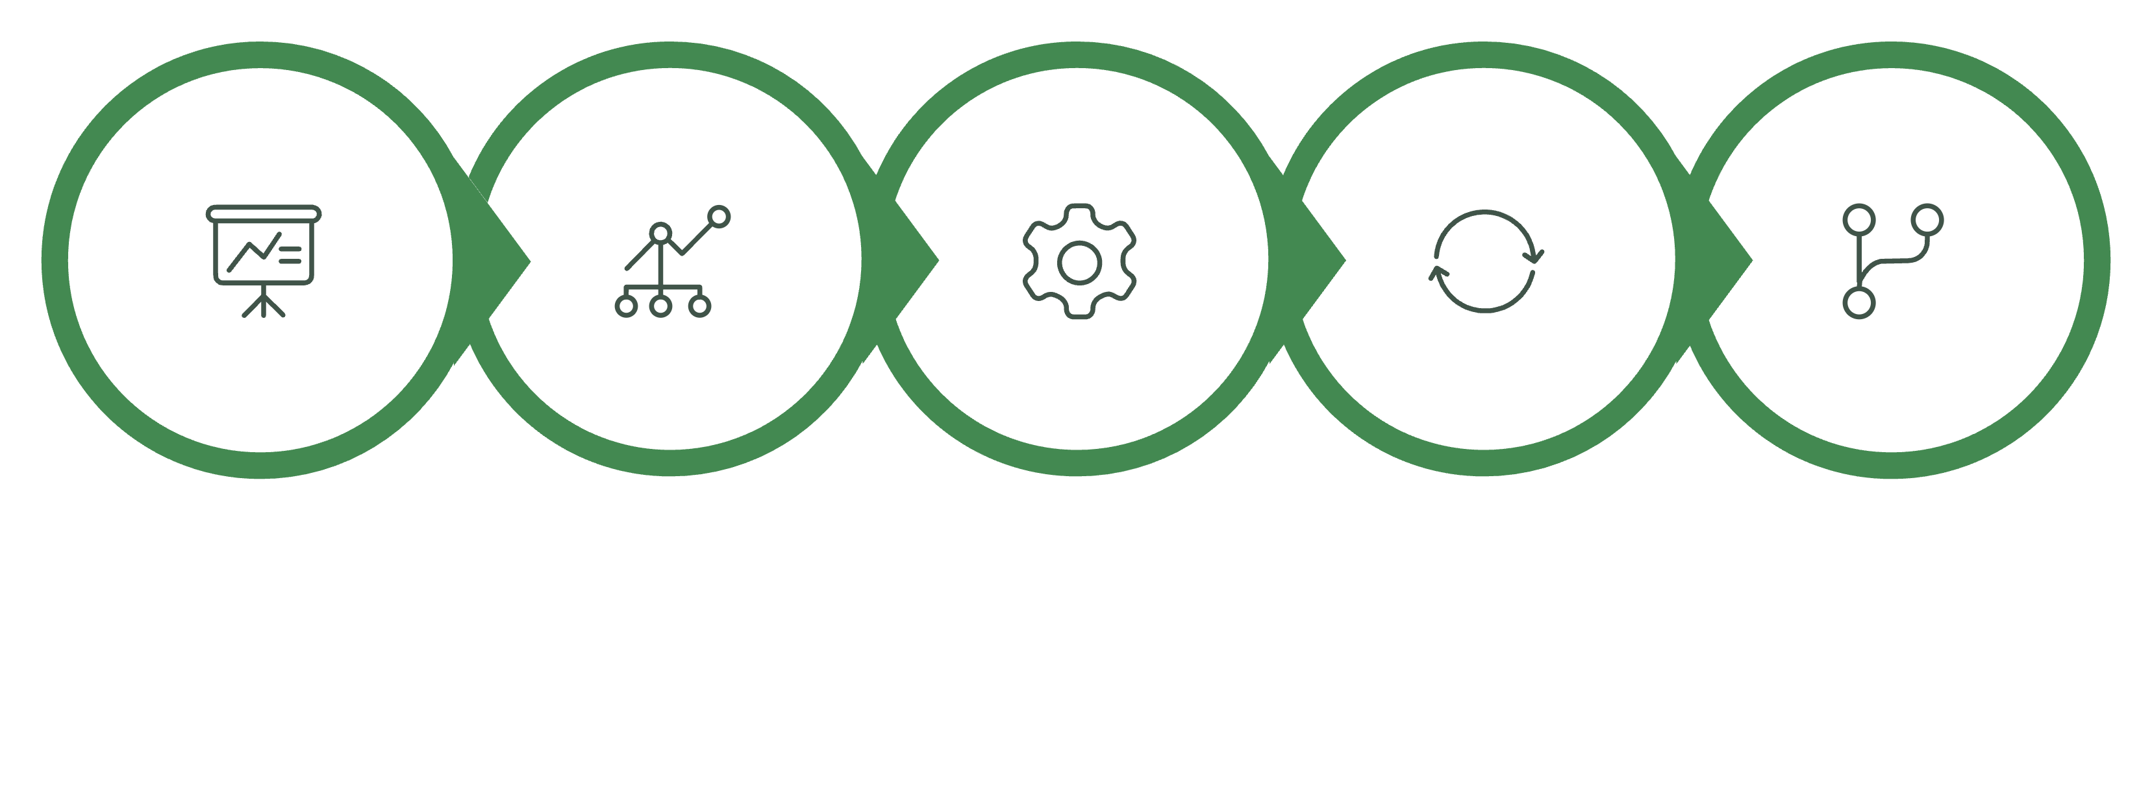
WORKFLOW
Work Completed During Week 3
From presenting initial findings to expanding experiments and applying optimisation techniques across multiple models.
Apply Quantization
Present Results
Expand Profiling
Re-run & Compare
Update Repos
Each step built upon the previous week's foundation, broadening the scope from two models to four and introducing quantisation as an optimisation strategy.

Slide 3
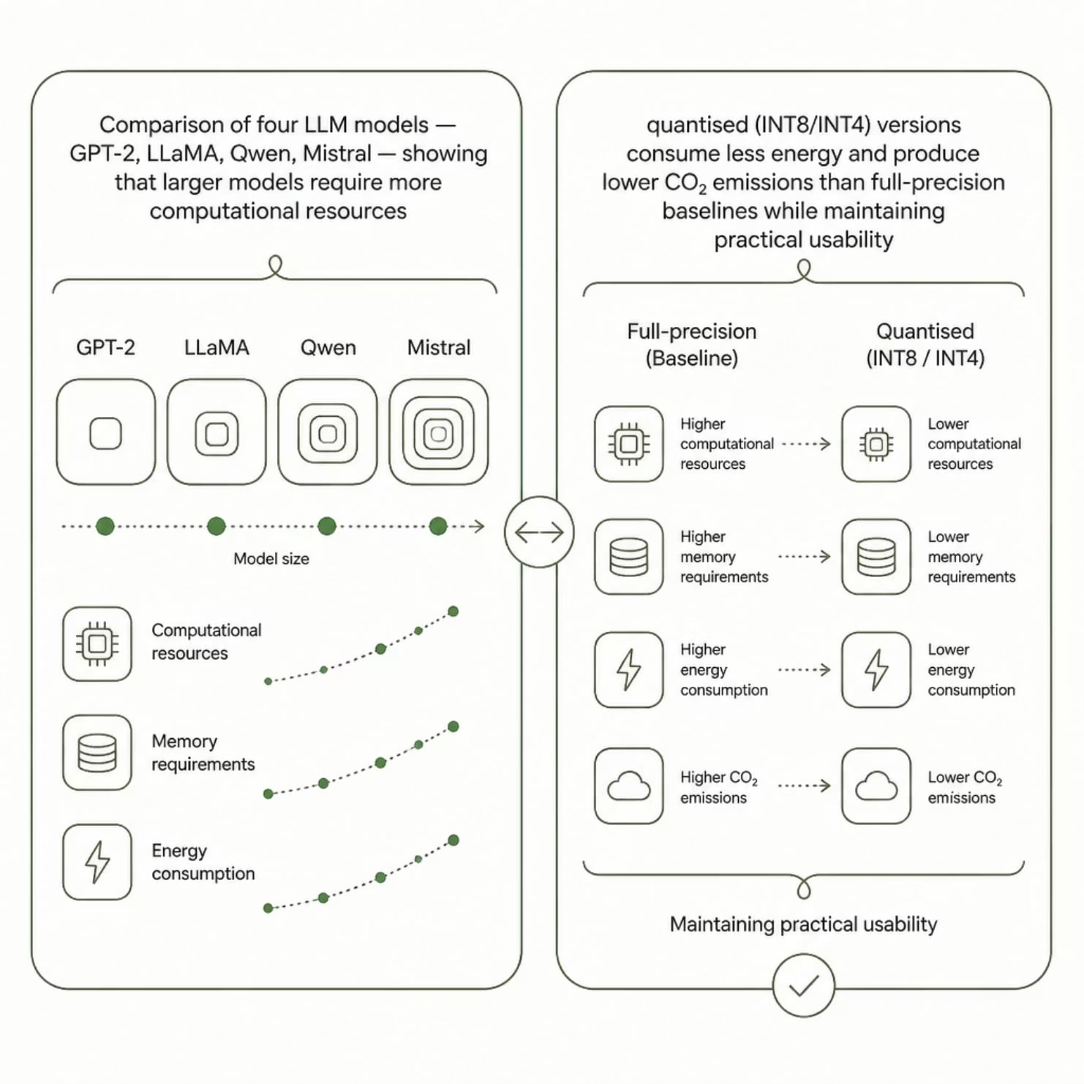
EXPERIMENTS & FINDINGS
Energy Profiling & Quantisation Results
Models Evaluated
Methods & Tools
GPT-2 · LLaMA · Qwen · Mistral
Hugging Face Transformers · CodeCarbon · bitsandbytes (INT8/INT4)
Metrics Collected
Runtime · Energy consumption · CO₂ emissions · Hardware utilisation

Slide 4




KEY OBSERVATIONS
What the Data Showed
Model Scale Matters
Larger models consistently required more computational resources, resulting in higher energy consumption and emissions during inference.
Quantisation Reduces Energy
Both INT8 and INT4 quantised models consumed significantly less energy than their full-precision counterparts, with measurable CO₂ reductions.
Usability Preserved
Quantisation improved inference efficiency while maintaining practical usability — output quality remained acceptable for downstream tasks.

Slide 5
DELIVERABLES
Project Outputs
All code, reports, and results have been documented and shared across open-source platforms for reproducibility.
1
Profiling Scripts
Qwen & Mistral energy profiling code
2
Quantisation Code
INT8 / INT4 implementation using bitsandbytes
3
Comparison Tables
Energy and CO₂ metrics across all models
4
Before vs After Analysis
Full-precision vs quantised performance
5
Findings Report
Summary of Week 3 results and insights
6
Platform Updates
GitHub, Hugging Face, and Kaggle refreshed

Slide 6

REFLECTION
Key Learnings
Cross-Model Energy Awareness
Learned how energy consumption varies across multiple open-source LLMs under identical workloads.
Hands-On Quantisation
Gained practical experience applying INT8 and INT4 quantisation to reduce model footprint without breaking usability.
Optimisation for Sustainability
Observed first-hand how optimisation techniques can meaningfully reduce AI energy usage and carbon emissions.
Research Discipline
Improved skills in experimental analysis, reproducibility, and structured research documentation.
"Week 3 expanded the project from measuring AI energy consumption to exploring practical optimisation techniques that support more sustainable and environmentally efficient Generative AI systems."

